Slide 1
Discounting, Equity, Risk
Time
Ramsey rule
Declining discount rates
Space
Equity weights
Risk
Expectations
Certainty equivalents
All together now
How to choose ethical parameters

Slide 2
Lectures
Science
Scenarios & emission reduction options
Costs of emission reduction
Instruments for emission reduction
Impacts of climate change & valuation
Economic impacts of climate change
Climate and development
Adaptation policy
Optimal emission reduction
Discounting, equity, risk
International environmental agreements

Slide 3
Discounting, Equity, Risk
Time
Ramsey rule
Declining discount rates
Space
Equity weights
Risk
Expectations
Certainty equivalents
All together now
How to choose ethical parameters

Slide 4
Optimal emission reduction
Climate change is long-term, global, uncertain problem
If you do not care about the distant future, far-away lands, remote probabilities, you do not care about climate change

Slide 5
Optimal emission reduction
Climate change is long-term, global, uncertain problem
If you do not care about the distant future, far-away lands, remote probabilities, you do not care about climate change

Slide 6
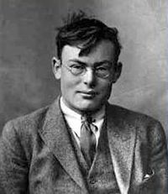

Time discounting
The Ramsey rule of discount
That is, we discount the future because
We will be richer and happier then
$$r=ρ+ηg$$

Slide 9

Time discounting
The Ramsey rule of discount
That is, we discount the future because
We will be richer and happier then
We are impatient
Note that the Ramsey rule describes the consumption side of intertemporal trade-offs – on the production side, there is the opportunity cost of capital
In a dynamic equilibrium, the two are equal
Discounting matters
$$r=ρ+ηg$$

Slide 10
No equity, no uncertainty

Slide 12
Time discounting
The Ramsey rule of discount
That is, we discount the future because
We will be richer and happier then
We are impatient
Impatience is controversial
On the one hand, we all are
Much evidence that people discount the future
On the other hand, we all know we should not be
Every religion, ethics argues for patience
$$r=ρ+ηg$$

Slide 13
Discounting, Equity, Risk
Time
Ramsey rule
Declining discount rates
Space
Equity weights
Risk
Expectations
Certainty equivalents
All together now
How to choose ethical parameters

Slide 14
Declining discount rates
Discounting should
Reflect the will of the people
Not ignore the far future
Be consistently applied accross public policy
Can this be done?

Slide 15
Declining discount rates
Discounting should
Reflect the will of the people
Not ignore the far future
Be consistently applied accross public policy
Can this be done?
Conventional, exponential discount rates have that the relative distance between two years does not depend on the time horizon
exp(-ρ(t+δ)) / exp(-ρt) = exp(-ρδ)

Slide 16

Hyperbolic Discount Rates
The relative distance between two years does not depend on the time horizon:
exp(-ρ(t+δ)) / exp(-ρt) = exp(-ρδ)
This is strange: The difference between year 10 and year 11 is the same as the difference between year 100 and year 101, and between 1000 and 1001
There is experimental and observational evidence that suggests that people use a lower discount rate when they look further into the future

Slide 17

Hyperbolic Discount Rates -2
There is experimental and observational evidence that suggests that people use a lower discount rate when they look further into the future, perhaps
exp(-ρln(t+δ)) / exp(-ρlnt) = exp(-ρln(1+δ/t))
Then, the difference between year 10 and year 11 is the same as the difference between year 100 and year 110, and between 1000 and 1100

Slide 18
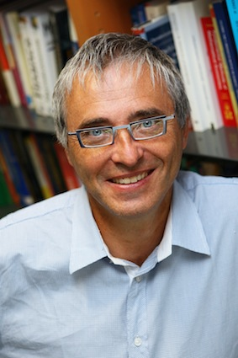
Declining Discount Rates
A similar effect (but not identical) can be achieved through disagreement

Slide 19

Declining Discount Rates
A similar effect (but not identical) can be achieved through uncertainty

Slide 20
Declining Discount Rates -2
If we assume that the discount rate is uncertain and follows a Gamma distribution, then the certainty-equivalent discount rate equals
r(t) = α / (1+βt)
where α is a location parameter and β a spread parameter
SCC ($/tC) | DDR | CDR
Green Book | 18 | 6.6
Gamma | 88 | 2.1
DDR: Declining discount rate
CDR: Constant discount rate, starting at the same rate as the DDR

Slide 21
Discounting, Equity, Risk
Time
Ramsey rule
Declining discount rates
Space
Equity weights
Risk
Expectations
Certainty equivalents
All together now
How to choose ethical parameters

Slide 22
Optimal emission reduction
Climate change is long-term, global, uncertain problem
If you do not care about the distant future, far-away lands, remote probabilities, you do not care about climate change

Slide 23
Differences in Values
Impacts of climate change differ greatly between countries

Slide 25
Differences in Values
Impacts of climate change differ greatly between countries
Initially, people just added the monetised climate change impacts
This caused a furore: Health risks reflect ability to pay, differ with income
Value of a statistical life is an empirical quantity
Internal consistency is important too
Instead, one can use different weights for different countries

Slide 26
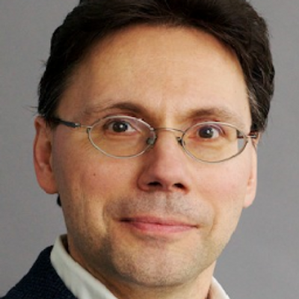
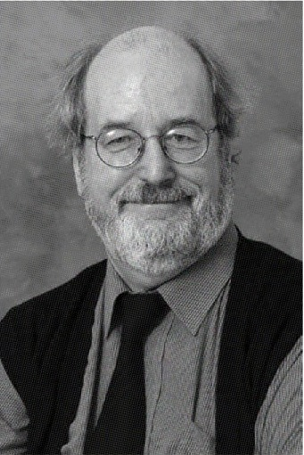
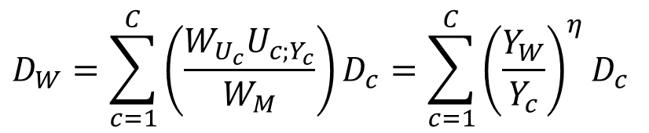
Equity Weights
Fankhauser, Pearce & Tol
Damage in money in country c is first transformed to damage in utility in country c
Then transformed to damage in global welfare
And finally transformed back to money
$$D_{W}=\sum_{c=1}^{C}{\left(\frac{W_{U_{c}}U_{c;Y_{c}}}{W_{M}}\right)D_{c}}=\sum_{c=1}^{C}{{\left(\frac{Y_{W}}{Y_{c}}\right)}^{η}D_{c}}$$

Slide 27

Equity Weights
Fankhauser et al:
National impacts valued at world average
$$D_{W}=\sum_{c=1}^{C}{\left(\frac{W_{U_{c}}U_{c;Y_{c}}}{W_{M}}\right)D_{c}}=\sum_{c=1}^{C}{{\left(\frac{Y_{W}}{Y_{c}}\right)}^{η}D_{c}}$$
$$D_{W}=\sum_{c=1}^{C}{{\left(\frac{Y_{W}}{Y_{c}}\right)}^{η}D_{c}}=\sum_{c=1}^{C}{{\left(\frac{Y_{W}}{Y_{c}}\right)}^{η}V_{c}I_{c}}= \\ \sum_{c=1}^{C}{{\left(\frac{Y_{W}}{Y_{c}}\right)}^{η}V_{W}{\left(\frac{Y_{c}}{Y_{W}}\right)}^{ε}I_{c}}\overset{ε=η}{=}\sum_{c=1}^{C}{V_{W}I_{c}}$$

Slide 28
No equity, no uncertainty
Equity, no uncertainty

Slide 30
Discounting, Equity, Risk
Time
Ramsey rule
Declining discount rates
Space
Equity weights
Risk
Expectations
Certainty equivalents
All together now
How to choose ethical parameters

Slide 31
Optimal emission reduction
Climate change is long-term, global, uncertain problem
If you do not care about the distant future, far-away lands, remote probabilities, you do not care about climate change

Slide 32
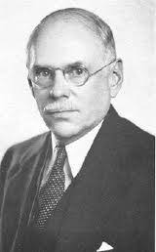
Risk v Uncertainty
Risk = uncertain but with known probabilities
Uncertainty = uncertain with unknown probabilities

Slide 35
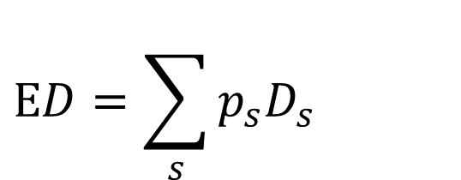

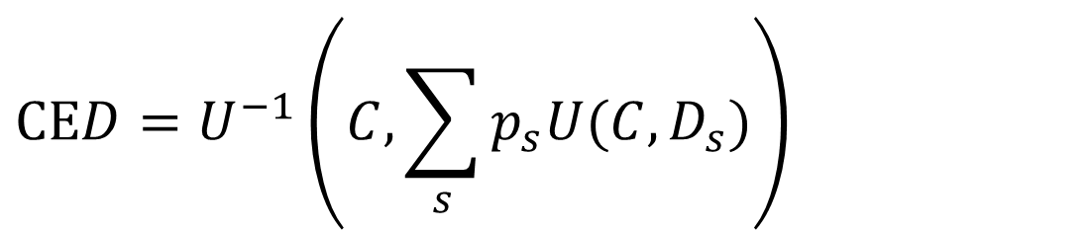
Risk
Expected damage
Certainty equivalent damage
Risk premium
$$ED=\sum_{s}{p_{s}D_{s}}$$
$$\text{CE}D=U^{−1}\left(C,\sum_{s}{p_{s}U(C,D_{s})}\right)$$
$$RP\text{=}\text{CE}D\text{−}\text{E}D$$

Slide 38
No equity, no uncertainty
No equity, uncertainty

Slide 40
Discounting, Equity, Uncertainty
Time
Ramsey rule
Declining discount rates
Space
Equity weights
Risk
Expectations
Certainty equivalents
All together now
How to choose ethical parameters

Slide 41
No equity, no uncertainty
Equity, no uncertainty
No equity, uncertainty
Equity, uncertainty

Slide 42
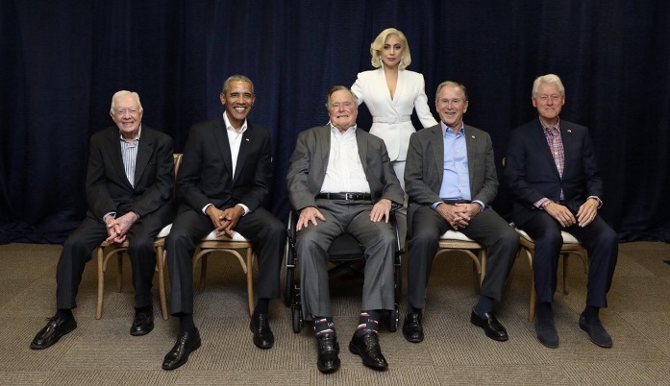
What values
The rates of pure time preference, inequity aversion, and risk aversion describe how much we care about the future, others, uncertainties
Two approaches to such ethical parameters
Philosophy, religion
Would what Socrates, Jesus, Lao Tzu, Mohammed, Johnny Rotten, Lord Stern, Lady Gaga do?
Revealed preferences
What does the average person do?
Consistency is crucial (cf. Schelling)
If you don’t care about Africa in your trade policy, why do you care about Africa in your environmental policy?

